Slide 1

Neural Mechanisms of Working Memory Christos Constantinidis, Ph.D. Department of Biomedical Engineering
NURO 8340 26-Oct-2022

Slide 2
Outline
Neural correlates of working memory
Persistent activity models
Rhythmic models
Activity-silent models
Notes:
Refrigerator analogy: it vibrators

Slide 3
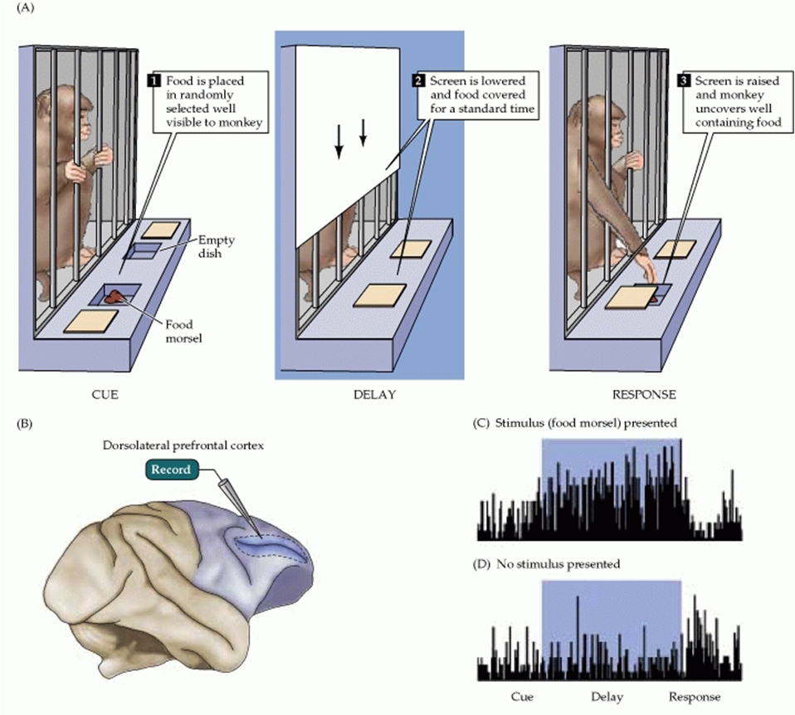
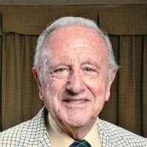
Persistent Discharges
Persistent discharges in prefrontal cortex and MD thalamus
Neuron activity related to short-term memory.
Fuster JM, Alexander GE.
Science. 1971 173(3997):652-4

Slide 4
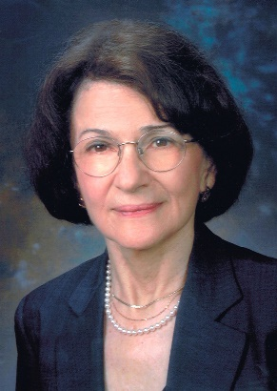
Delayed Response Task
Fixation
Cue
Delay
Fixation Off
Saccade
Funahashi et al., J. Neurophysiology, 1989

Slide 5
Recurrent Excitation
From Durstewitz et al. (2000)

Slide 6
Prefrontal Anatomical Organization
Kritzer and Goldman-Rakic, 1996
From Kritzer and Goldman-Rakic (1995)

Slide 7
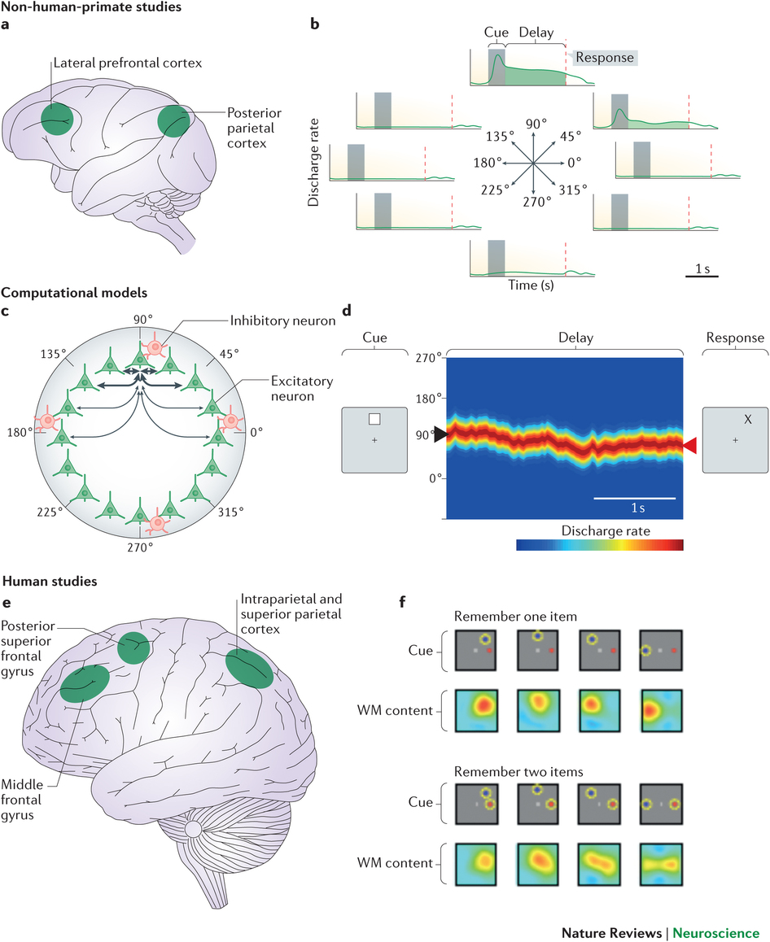
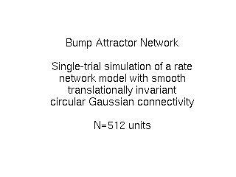
Recurrent Excitation
Constantinidis & Klingberg,
Nature Rev. Neurosci. 2016
Wimmer et al, Nature Neuroscience, 2014
From Durstewitz et al. (2000)
Notes:
Use it again

Slide 8
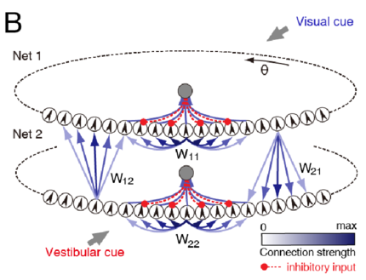
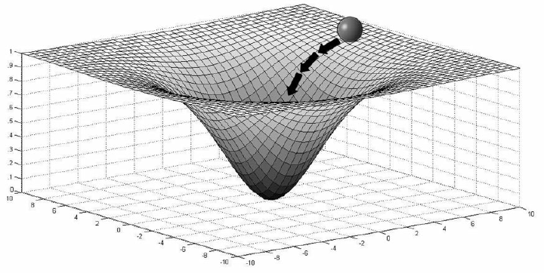
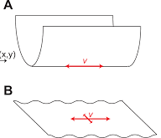
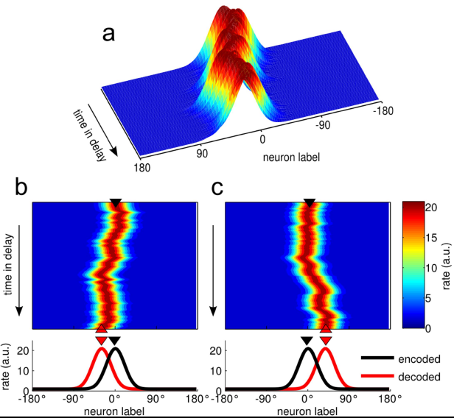
Attractor Networks
Fixed Point Attractor
Continuous Attractor
Line Attractor
Bump Attractor

Slide 9
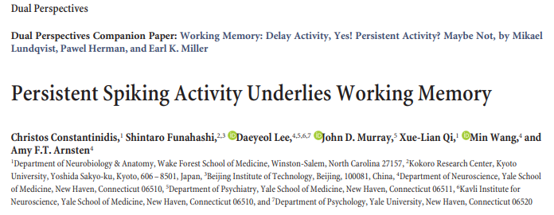
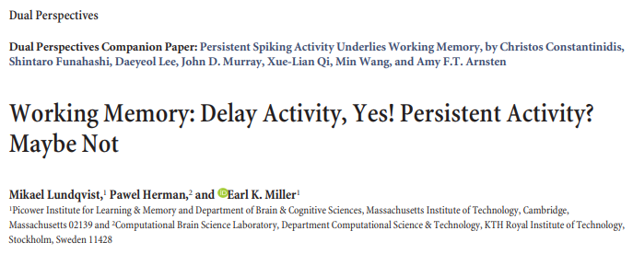

Neural Mechanisms of WM
“Dual Perspectives”, Journal of Neuroscience (2018)

Slide 10
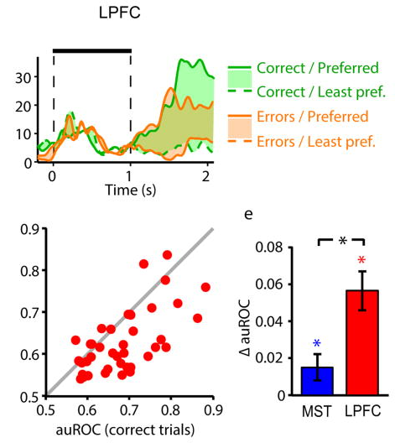
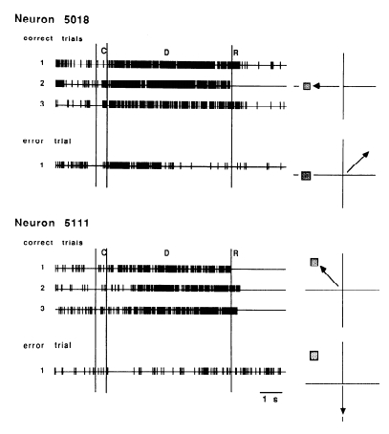
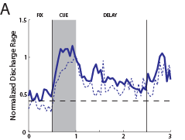
Persistent discharges explain behavior
Lower activity in error trials
Funahashi, Bruce, and Goldman-Rakic, 1989
From Zhou et al., J. Neurophysiology, 2013
Mendoza-Halliday et al., 2014

Slide 11
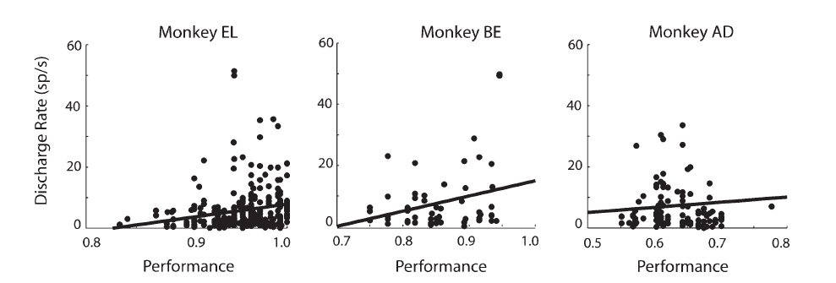
Persistent Activity Predicts Performance
Higher activity in sessions with higher performance
Qi et al., Cerebral Cortex, 2011

Slide 12
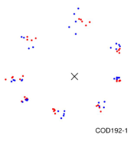
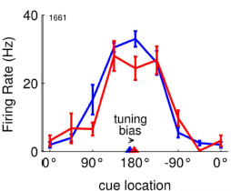
Source of Errors in Bump Attractor Model
Wimmer et al, Nature Neuroscience, 2014

Slide 13
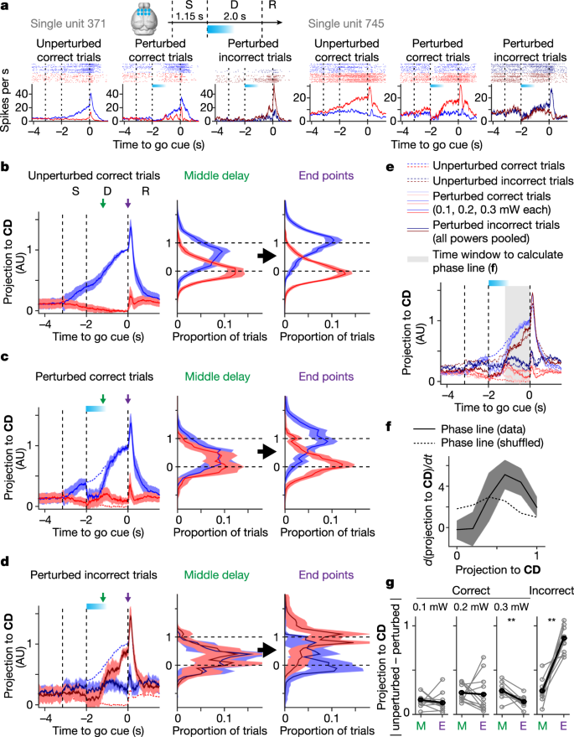
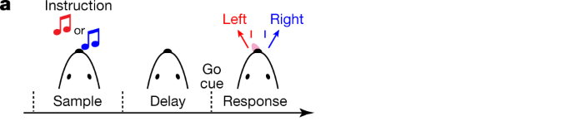
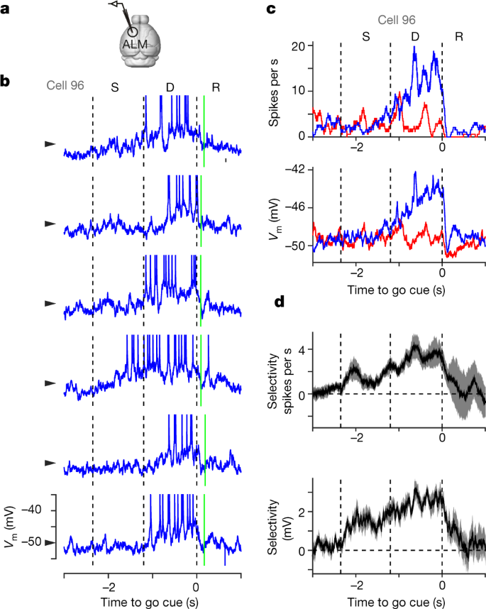
Attractor Perturbation
Inagaki et al, Nature, 2019

Slide 14
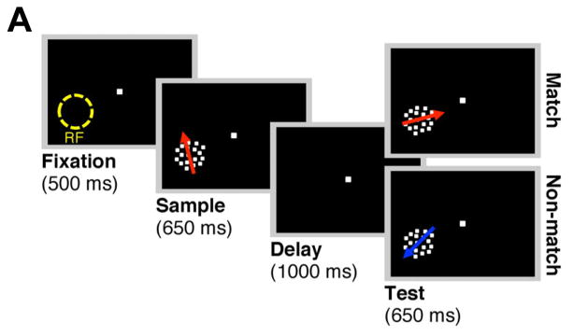
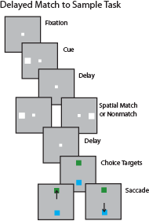
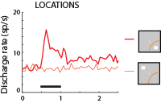
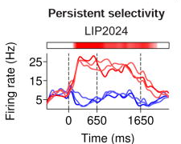
Stimulus vs. motor preparation
Meyer et al., J. Neuroscience 2011
Chaisangmongkon, Swaminathan, Freedman, and
Xiao-Jing Wang, Neuron, 2017

Slide 15
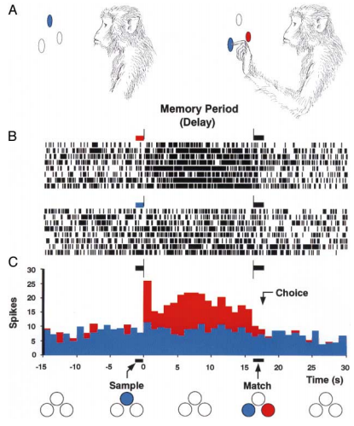
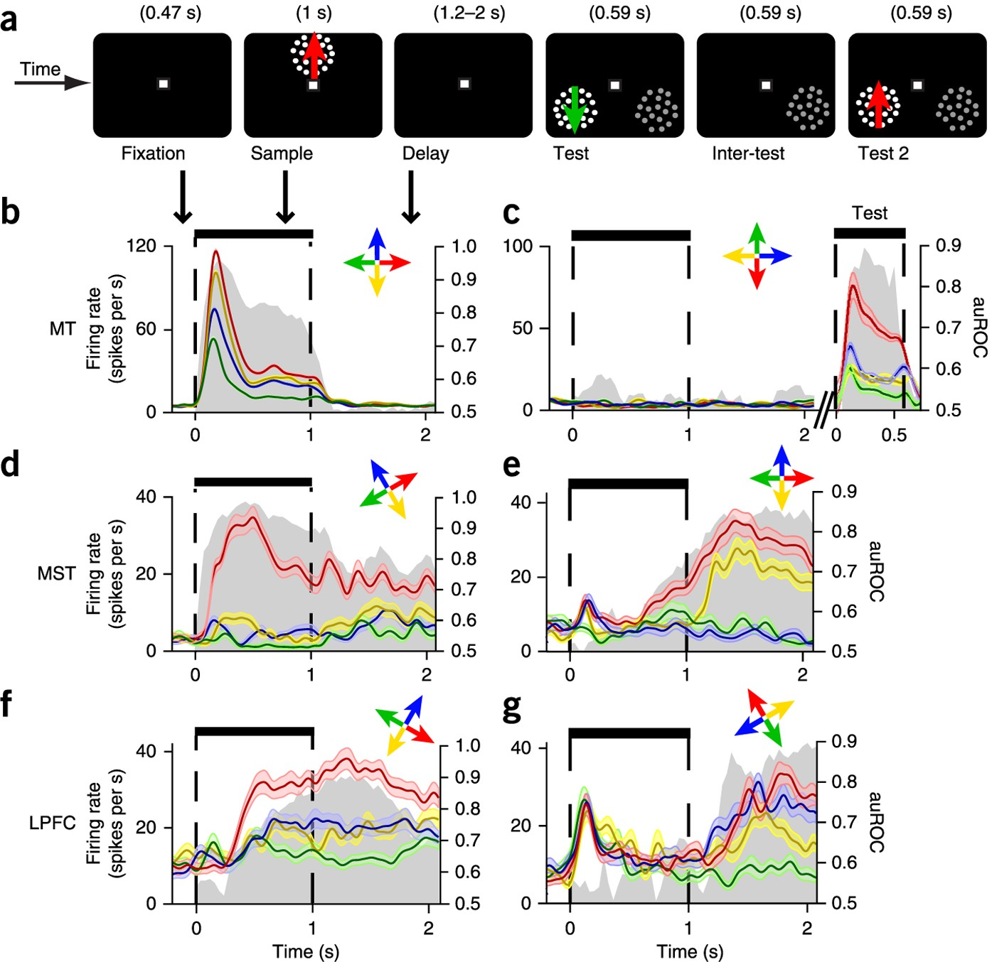
Non-spatial information
Direction of Motion
Mendoza-Halliday et al., 2014
Color, Fuster and Jervey 1982
Stimulus Shape
Qi et al., 2014
Other sensory modalities:
Frequency of vibration, auditory pitch etc.

Slide 16
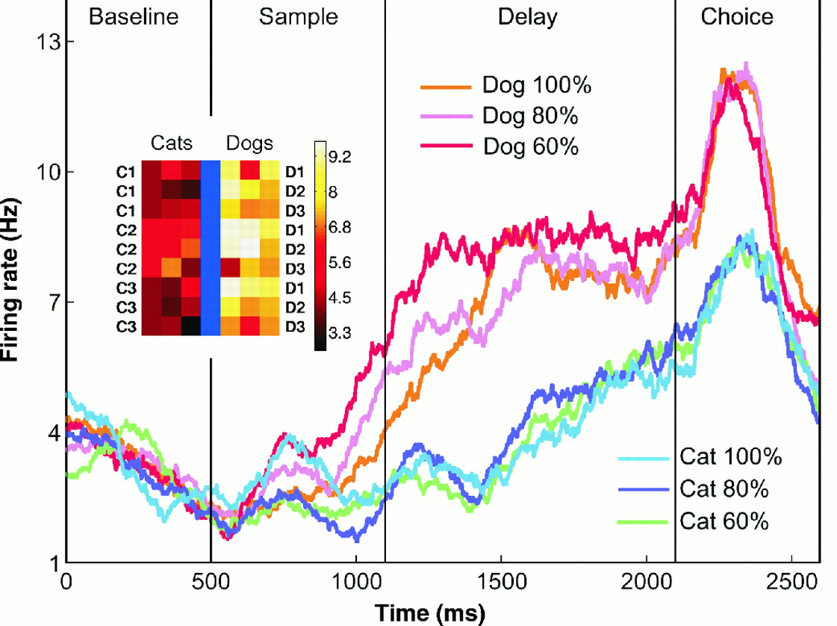
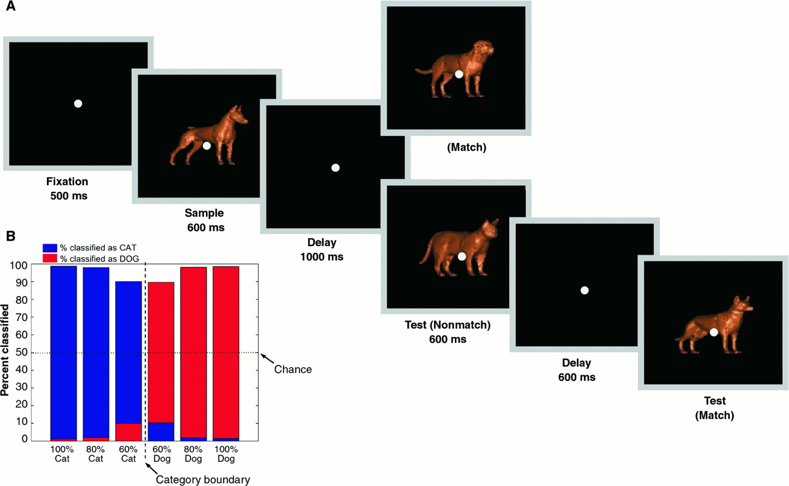
Persistent Activity for Abstract Qualities
Categories
Freedman, Riesenhuber, and Miller., Science, 2001

Slide 17
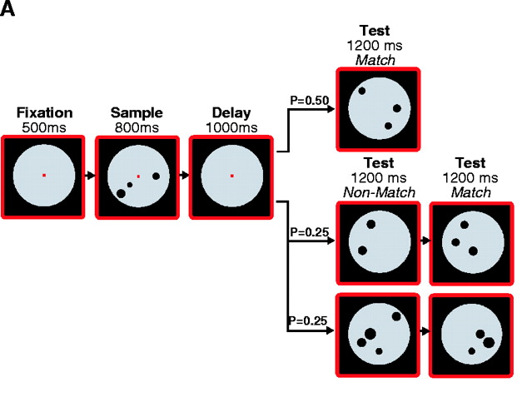
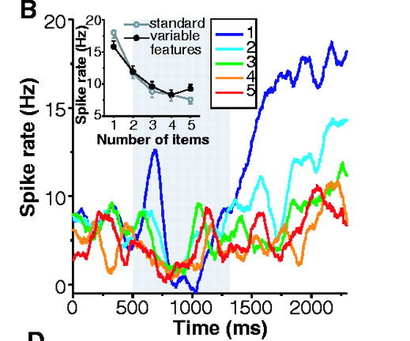
Persistent Activity for Abstract Qualities
Numerical quantities
Nieder, Freedman, and Miller., Science, 2002

Slide 18
Persistent Activity without Working Memory
Meyer et al., J. Neuroscience 2011

Slide 19
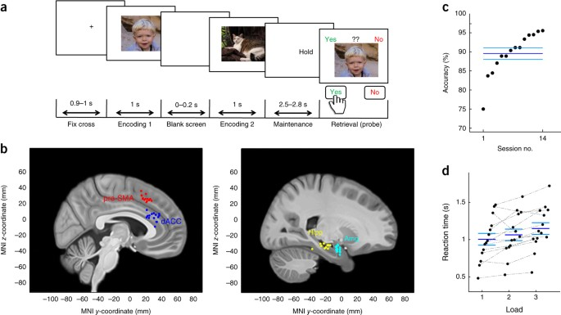
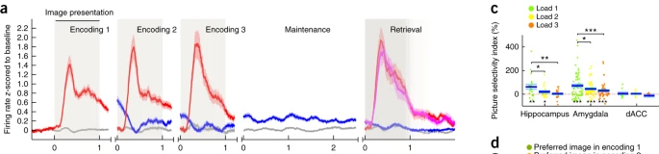
Persistent Activity in Humans
Medial Temporal Lobe, incl. Hippocampus & Amygdala
Kaminski et al., Nature Neuroscience, 2017

Slide 20
Outline
Neural correlates of working memory
Persistent activity models
Rhythmic models
Activity-silent models
Notes:
Refrigerator analogy: it vibrators

Slide 21
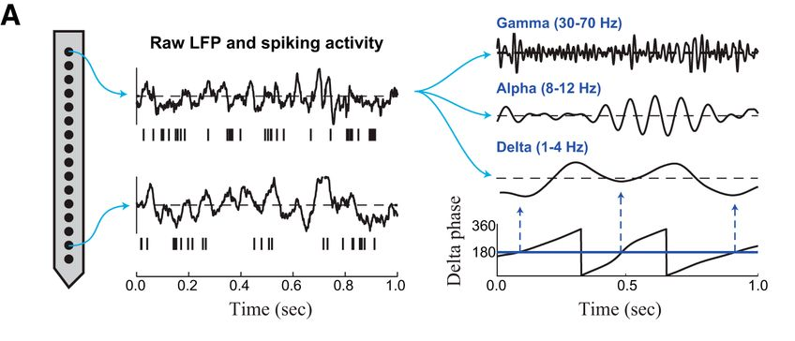
LFP Power Spectrum
Power decays as a function of frequency (1/f)
Stimulus and cognitive modulation has been reported in following frequency bands:
δ (1-4 Hz)
θ (4-8 Hz)
α (8-12 Hz)
β (12-30 Hz)
γ (30-100 Hz)
Approximately!

Slide 22
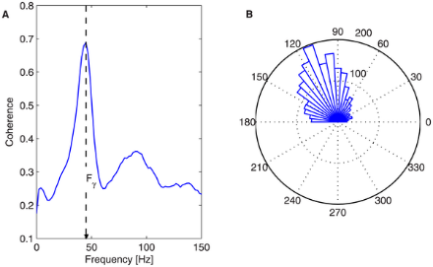
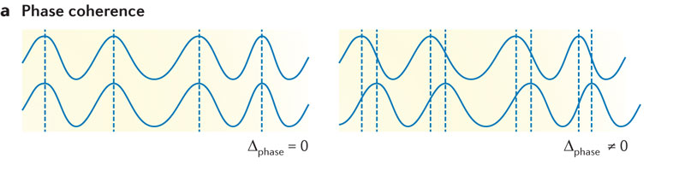
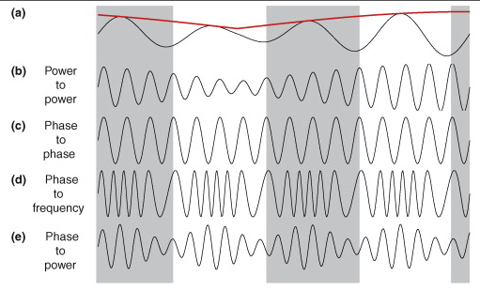
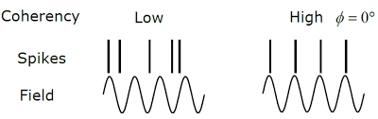
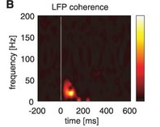
Coherence between electrodes
We can calculate the lag between two LFP signals.
Since this are periodic signals, it can be expressed as “phase”
Phase differences can be
estimated across trials:
coherence
Coherence depends on
frequency
Exactly the same analysis applies to “Spike-field” coherence
We can then plot coherence as a
function of frequency and time
Cross-frequency coupling

Slide 23
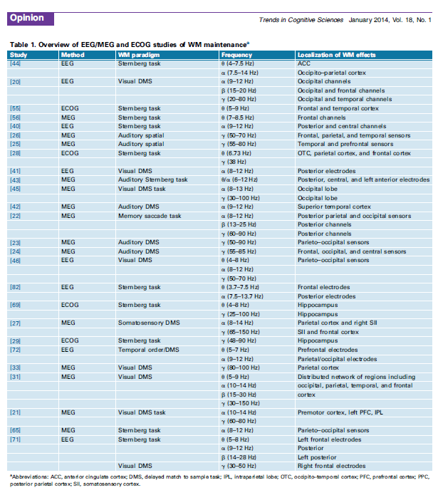
Rhythmicity in Human WM Studies
Roux and Uhlhaas, 2014
Notes:
Sternberg task: see sequence of letters; delay; single letter probe: press yes or no if you have seen it

Slide 24
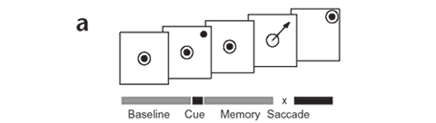
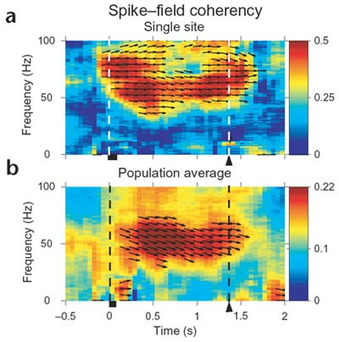
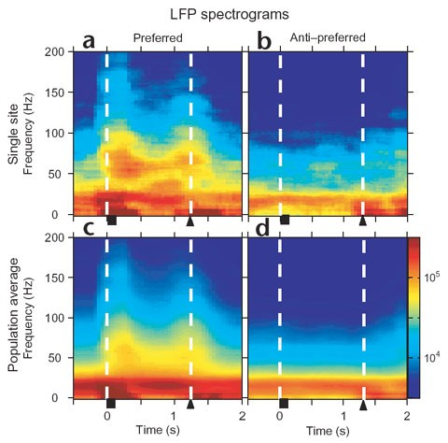
Rhythmicity during WM
Pesaran et al., Nature Neuroscience, 2002

Slide 25
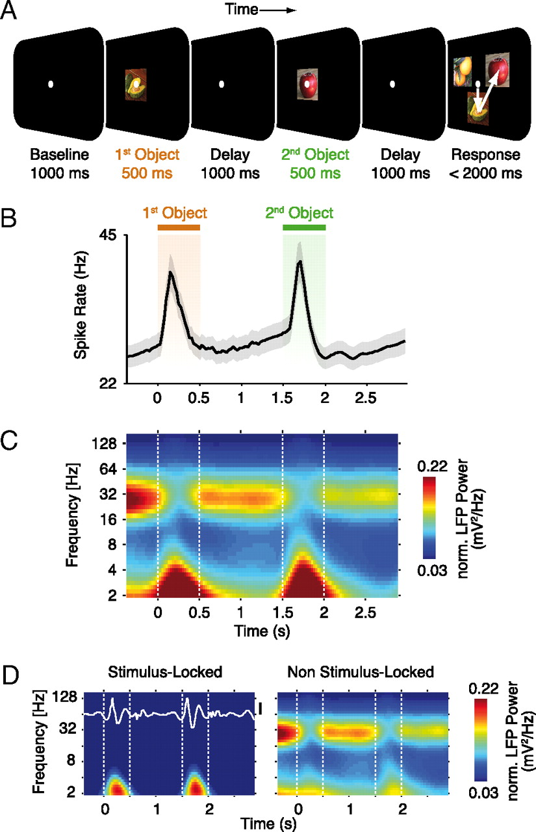
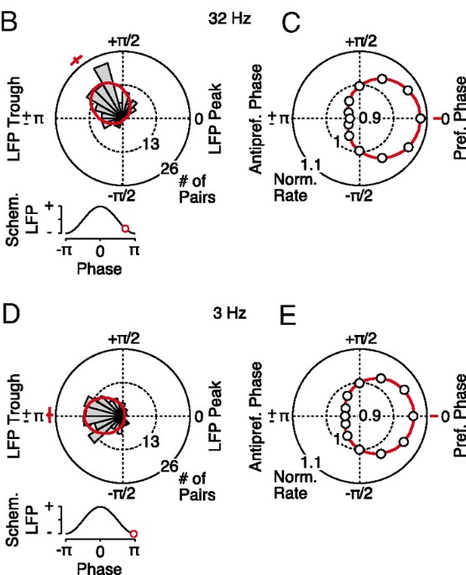
Phase synchronization differs for two items
Phase of spike-LFP coherence differs between first and second item
Siegel et al., PNAS, 2009

Slide 26
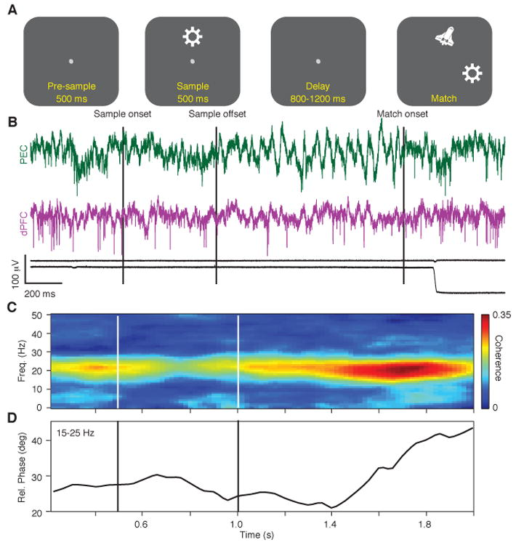
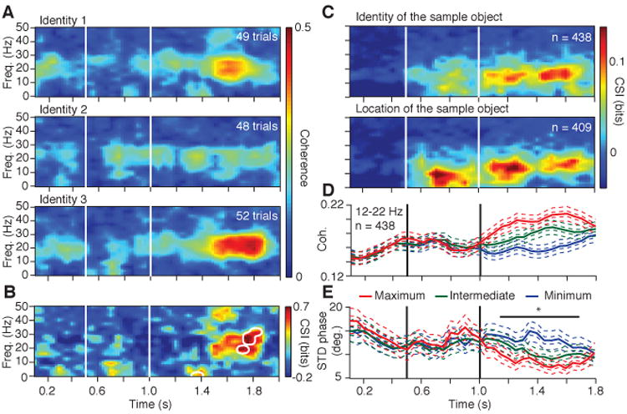
Coherence between areas
Coherence Selectivity during delay across sample
Prefrontal – Parietal LFP coherence
“Coherence Selectivity Index”
in one pair of sites
Salazar et al., Science, 2012

Slide 27
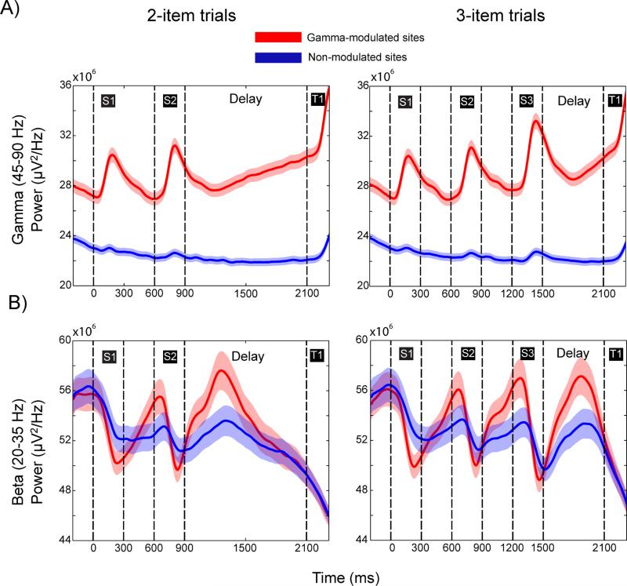
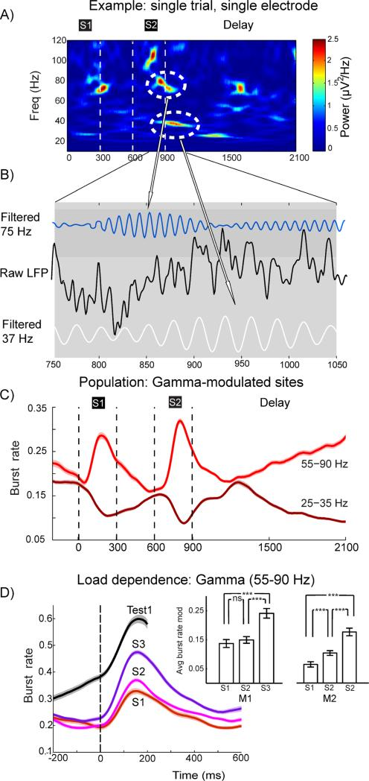
Rhythmicity based model
Lundqvist et al., Neuron, 2016

Slide 28
Outline
Neural correlates of working memory
Persistent activity models
Rhythmic models
Activity-silent models
Notes:
Refrigerator analogy: it vibrators

Slide 29
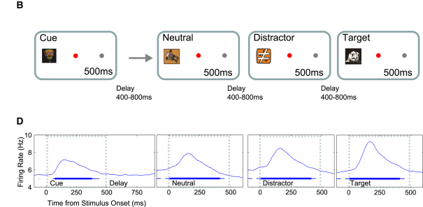
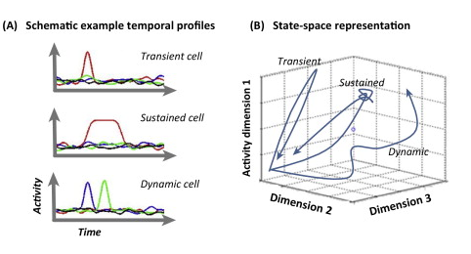

Decoding information without increase in firing rate
Mean firing rate in delay period not elevated
Stimulus could still be decoded from activity
Stokes, Trends in Cognitive Science, 2015

Slide 30

Dual Task – Reactivation
From Watanabe and Funahashi, Nature Neuroscience, 2014

Slide 31




Repetition Suppression
IT Cortex: Miller and Desimone, 1991
Prefrontal Cortex: Qi et al. 2012
PPC Cortex: Steinmetz et al., 1994
Notes:
Most of these neurons did not generate persistent activity
Some opposite: enhancement

Slide 32


Repetition Suppression
fMRI
EEG
From Grill-Spector et al.

Slide 33


TMS can reactivate latent memory
From Rose et al., Science, 2016
Notes:
fMRI + TMS

Slide 34


Silent Mechanisms
u: Utilization
x: Availability
Mongillo et al., Science, 2008
Notes:
Pinging the brain with an activation pulse

Slide 35


Reconciling Spiking and Activity Silent Mechanisms
Barbosa et al, Nature Neuroscience (2020)

Slide 36
Summary
Prefrontal neurons generate persistent discharges during delay period of working memory tasks
Activity is tuned for spatial location
Bump Attractor models accurately capture properties of neural activity, predict behavior in working memory tasks
Persistent activity is generated independently of motor preparation
Represents all kinds of stimulus attributes, abstract qualities
Present even in naïve subjects, with no explicit working memory training
Present in human cerebral cortex

Slide 37
Summary (cont.)
Rhythmic activation at the LFP/EEG/MEG level is readily generated during working memory
Models of memory have proposed that rhythmicity of spikes relative to the LFP is critical variable of memory maintenance
Information can be extracted by neuronal activity during working memory even without overall increase in firing rate
Synaptic mechanisms can account for modulations in firing rate during working memory without persistent activity
The spike reigns supreme: spiking activity ultimately explains behavior

